Slide 1
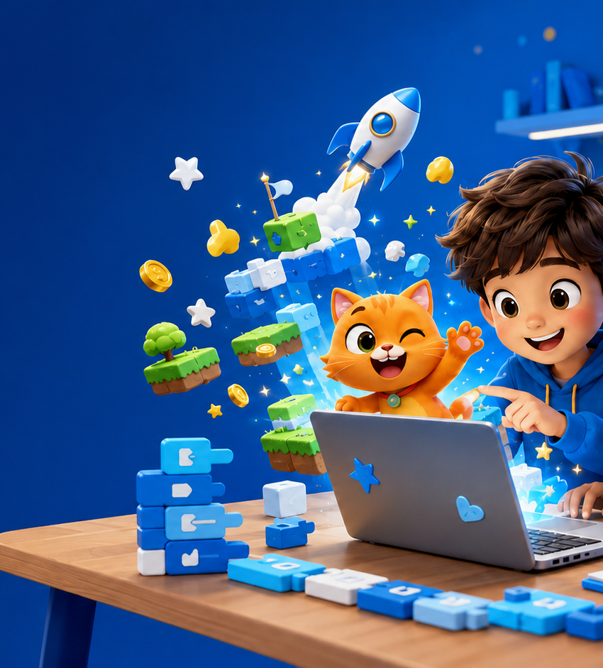
EASYSKILLS
SCRATCH CODING
FOR YOUNG CREATORS
From first blocks to an original game
your child can proudly share.
AGES 5–10
32 one-on-one online lessons
No experience needed
Notes:
[Sources]
- Visuals: AI-generated and recolored for EASYSKILLS in this presentation workflow.
- Course structure and offer details: EASYSKILLS information supplied in this project.
- Brand palette sampled from the supplied EASYSKILLS course PDF and logo.
[/Sources]

Slide 2
EASYSKILLS
02
Why parents choose EASYSKILLS.
Personal attention, clear progress, and projects children are excited to show.
✓
One-on-one instruction
The teacher adapts pace, explanations, and projects to the child.
THE EASYSKILLS DIFFERENCE
Every minute is focused
on your child.
✓
Learning through creation
Every new idea becomes part of a story, animation, quiz, or game.
More practice.
More questions answered.
More confidence to create.
✓
Progress you can see
Completed projects and teacher feedback make growth visible.
Notes:
[Sources]
- Visuals: AI-generated and recolored for EASYSKILLS in this presentation workflow.
- Course structure and offer details: EASYSKILLS information supplied in this project.
- Brand palette sampled from the supplied EASYSKILLS course PDF and logo.
[/Sources]

Slide 3
EASYSKILLS
03
Your child learns to think like a creator.
The goal is not more screen time. The goal is purposeful creation.
01
02
03
04
PLAN
BUILD
TEST
EXPLAIN
Break an idea into steps
Use coding logic to make it work
Find problems and improve the project
Show how the project works
Along the way, children practice focus, persistence, reasoning, and creative confidence.
Notes:
[Sources]
- Visuals: AI-generated and recolored for EASYSKILLS in this presentation workflow.
- Course structure and offer details: EASYSKILLS information supplied in this project.
- Brand palette sampled from the supplied EASYSKILLS course PDF and logo.
[/Sources]

Slide 4
EASYSKILLS
04
32 lessons. Five stages. One complete journey.
Guided first projects gradually lead to independent creation.
01
02
03
04
05
LESSONS 1–6
LESSONS 7–12
LESSONS 13–20
LESSONS 21–26
LESSONS 27–32
Explore
Animate
Design games
Level up
Create
The teacher adjusts the pace and project complexity without lowering the learning goals.
Notes:
[Sources]
- Visuals: AI-generated and recolored for EASYSKILLS in this presentation workflow.
- Course structure and offer details: EASYSKILLS information supplied in this project.
- Brand palette sampled from the supplied EASYSKILLS course PDF and logo.
[/Sources]

Slide 5
EASYSKILLS
05
STAGE 1 • LESSONS 1–6
Confident first steps in Scratch.
Short, playful challenges help young learners understand how actions on the screen connect to coding blocks.
CHILDREN LEARN
THEY CREATE
THE RESULT
Workspace • movement • sounds • sequences • events
A first animation and a short interactive scene
Confidence, cause-and-effect thinking, and the ability to follow a sequence
Notes:
[Sources]
- Visuals: AI-generated and recolored for EASYSKILLS in this presentation workflow.
- Course structure and offer details: EASYSKILLS information supplied in this project.
- Brand palette sampled from the supplied EASYSKILLS course PDF and logo.
[/Sources]

Slide 6
EASYSKILLS
06
STAGE 2 • LESSONS 7–12
Stories that move, speak, and respond.
Children bring characters to life and learn how timing, scenes, dialogue, and repetition shape a complete story.
CHILDREN LEARN
THEY CREATE
THE RESULT
Events • timing • costumes • backgrounds • loops
An animated story with characters and scene changes
Planning a sequence and communicating an idea clearly
Notes:
[Sources]
- Visuals: AI-generated and recolored for EASYSKILLS in this presentation workflow.
- Course structure and offer details: EASYSKILLS information supplied in this project.
- Brand palette sampled from the supplied EASYSKILLS course PDF and logo.
[/Sources]

Slide 7
EASYSKILLS
07
STAGE 3 • LESSONS 13–20
Games with goals, rules, and feedback.
Children move from animation to real game logic: controls, choices, challenges, score, and player feedback.
CHILDREN LEARN
THEY CREATE
THE RESULT
Loops • conditions • sensing • controls • score
Two playable mini-games with increasing challenge
Logical thinking, testing, persistence, and problem solving
Notes:
[Sources]
- Visuals: AI-generated and recolored for EASYSKILLS in this presentation workflow.
- Course structure and offer details: EASYSKILLS information supplied in this project.
- Brand palette sampled from the supplied EASYSKILLS course PDF and logo.
[/Sources]

Slide 8
EASYSKILLS
08
STAGE 4 • LESSONS 21–26
More complex projects. More independence.
Children combine several ideas, organize larger projects, and learn how to fix problems without losing control.
CHILDREN LEARN
THEY CREATE
THE RESULT
Variables • messages • levels • debugging • iteration
A multi-level game or an interactive quiz
Breaking a complex task into smaller, manageable parts
Notes:
[Sources]
- Visuals: AI-generated and recolored for EASYSKILLS in this presentation workflow.
- Course structure and offer details: EASYSKILLS information supplied in this project.
- Brand palette sampled from the supplied EASYSKILLS course PDF and logo.
[/Sources]

Slide 9
EASYSKILLS
09
STAGE 5 • LESSONS 27–32
An original idea becomes a finished project.
The final stage follows a complete creative process: choose, plan, build, test, improve, and present.
CHILDREN LEARN
THEY CREATE
THE RESULT
Project planning • design choices • testing • presentation
An original game, story, or interactive project
Ownership, creative confidence, and pride in a finished result
Notes:
[Sources]
- Visuals: AI-generated and recolored for EASYSKILLS in this presentation workflow.
- Course structure and offer details: EASYSKILLS information supplied in this project.
- Brand palette sampled from the supplied EASYSKILLS course PDF and logo.
[/Sources]

Slide 10
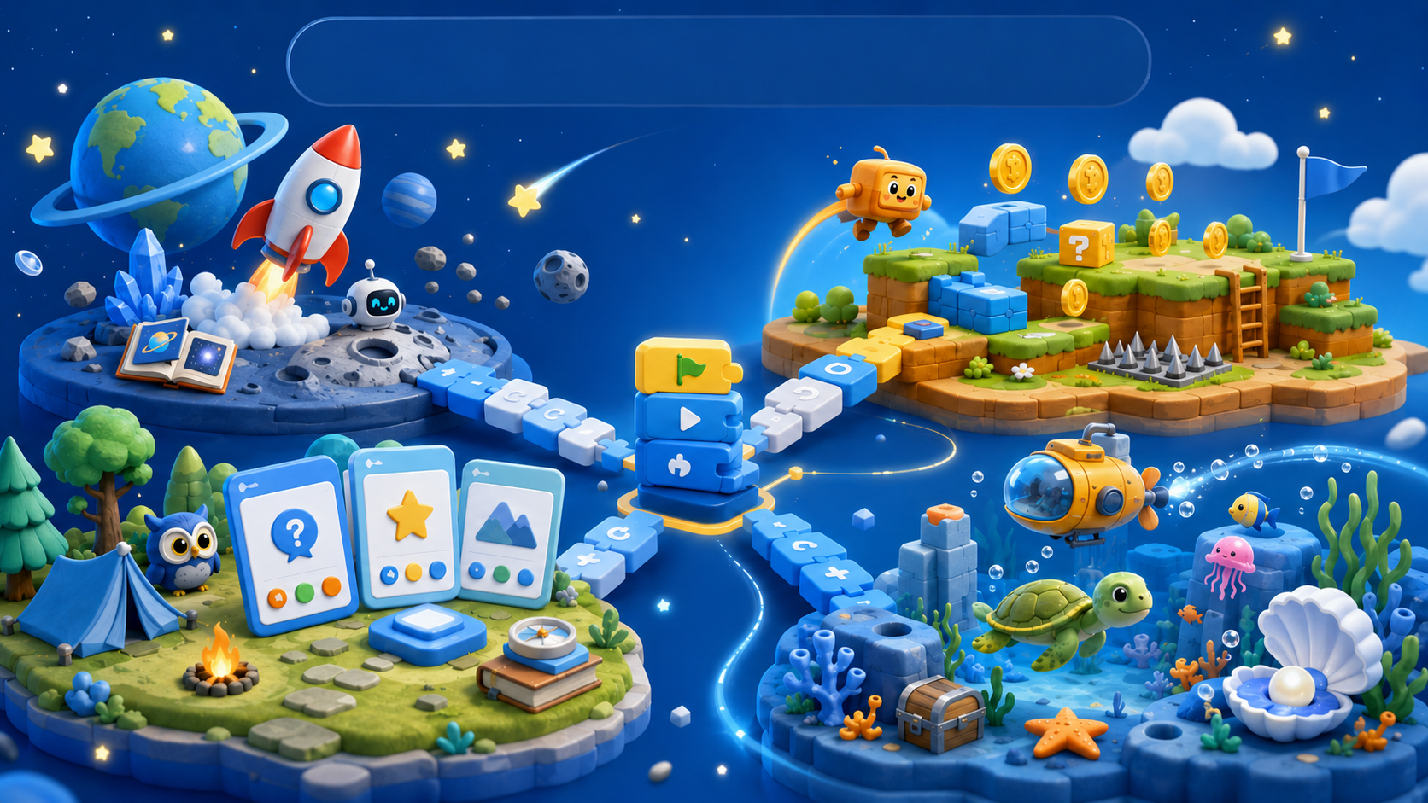
Projects make progress visible.
DIGITAL PORTFOLIO
Games • animated stories • quizzes • interactive art • an original final project
Notes:
[Sources]
- Visuals: AI-generated and recolored for EASYSKILLS in this presentation workflow.
- Course structure and offer details: EASYSKILLS information supplied in this project.
- Brand palette sampled from the supplied EASYSKILLS course PDF and logo.
[/Sources]

Slide 11
EASYSKILLS
11
Ambitious for every age. Adapted to each child.
The core learning goals stay strong while the teaching style changes.
AGES 5–6
AGES 7–10
Short, visual steps
More teacher guidance
Playful repetition
Simple stories and controls
More independent planning
Deeper game logic
Longer projects
More testing and explanation
Same destination. Different pace, language, support, and project complexity.
Notes:
[Sources]
- Visuals: AI-generated and recolored for EASYSKILLS in this presentation workflow.
- Course structure and offer details: EASYSKILLS information supplied in this project.
- Brand palette sampled from the supplied EASYSKILLS course PDF and logo.
[/Sources]

Slide 12
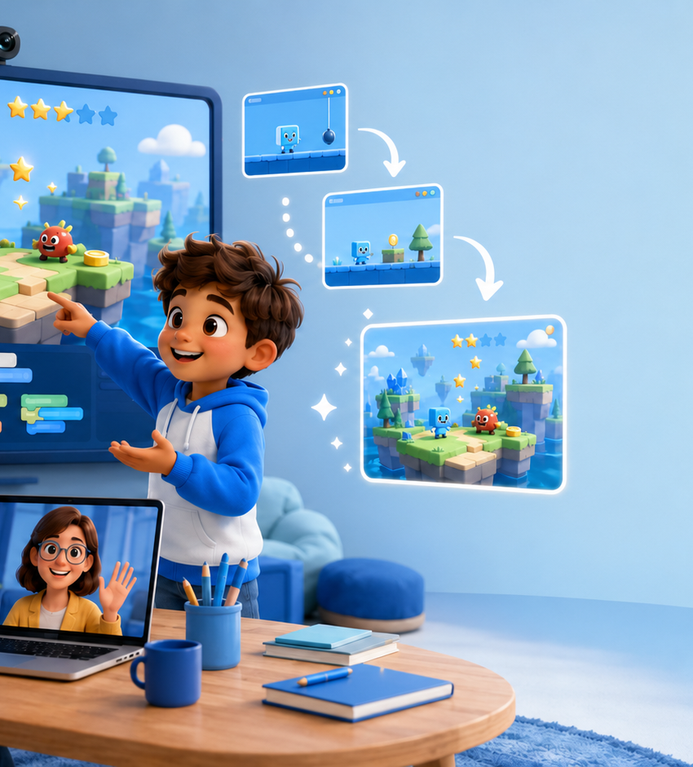
Progress parents can actually see.
Every milestone leaves visible evidence of learning.
PROJECTS
A growing portfolio of completed work
FEEDBACK
Teacher comments at meaningful milestones
CAPSTONE
A final original project
PRESENT
The child explains what they built
You see what your child can create—not only that a lesson was completed.
Notes:
[Sources]
- Visuals: AI-generated and recolored for EASYSKILLS in this presentation workflow.
- Course structure and offer details: EASYSKILLS information supplied in this project.
- Brand palette sampled from the supplied EASYSKILLS course PDF and logo.
[/Sources]

Slide 13
EASYSKILLS
13
Start with a free
60-minute trial lesson.
CREATE
Your child meets the teacher, tries Scratch,
and creates a first mini-project.
A FIRST
MINI-PROJECT
01
Meet the teacher
BOOK A FREE TRIAL
02
Try a creative coding task
03
Receive a starting-level recommendation
One-on-one online coding for ages 5–10
Notes:
[Sources]
- Visuals: AI-generated and recolored for EASYSKILLS in this presentation workflow.
- Course structure and offer details: EASYSKILLS information supplied in this project.
- Brand palette sampled from the supplied EASYSKILLS course PDF and logo.
[/Sources]

